Slide 1
Swearing at Fish for Money
Team 14

Slide 2
Creativity Cards
Metroidvania
Aquarium
Catch-em-all
Continuous Movement
No Weapons – but you can use harsh language.

Slide 3
The Game Idea
You own an Aquarium.
Your aquarium lacks fish.
You are too poor to afford any fishing equipment.
However, fish are easily upset…

Slide 4


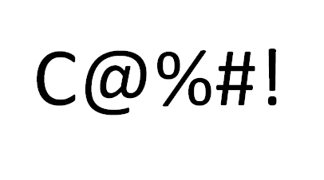


Moodboard

Slide 5
Mechanics
2D Metroidvania style platforming
Running into fish catches them for your aquarium.
Swearing at fish makes them slow down considerably and cry.
Different swear words have different areas of effect and can affect different fish types.
Catching fish earns you money (different fish are worth more than others).

